Slide 1
Analysis of restaurants in Bangalore
To get insight into the restaurant business in Bangalore and to help new entrepreneurs decision making.

Slide 2
Introduction
Bangalore is the capital city of Karnataka, India. One of the densely populated cities in India, there is huge opportunity for restaurants. But opening a restaurants needs a lot of planning. It is finally the customer who sustain the business. hence analysis of an existing data can bring out many factors, such as what item is popular in a locality, average price for food, etc.
Following are few considerations to be taken into account while opening a restaurant .
Ideal location - based on density of population and type.
Type of restaurant – North Indian, south Indian, Chinese, Café, bakery, etc
Target customers - richness, if they are ready to pay more
Competition - existing business and their performance parameters
Operating hours - what time or day of the week the people visit restaurants most often?
Size of restaurant - It should be small restaurant of few tables or large one?
Uniqueness - what makes the difference from other restaurants?
Apart from these there are several things like finance, policies, legal aspects.

Slide 3
The business problem
Let us try to address the following questions
Which is the ideal location in Bangalore for a south Indian restaurant?
What is the menu should be included? What price should be fixed for items?
Who are the biggest competitors?
What should be the seating capacity? How big should be restaurant?

Slide 4
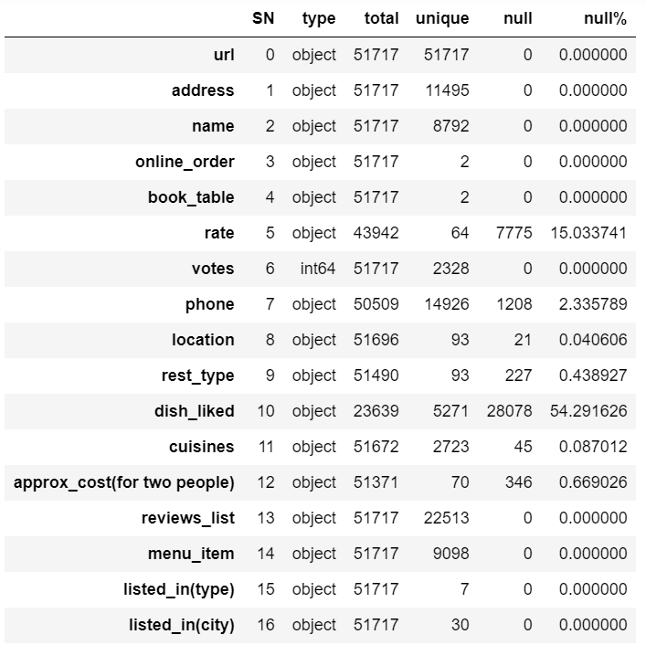
Data
In this analysis I will use the data provided by Zomato published on the Kaggle website. Following information can be obtained from the CSV file
Name, address, url, phone
Location, Type [ 2 sets found]
Rating, Votes
Cost for two
Online table booking and ordering facilities
Cuisines, dishes liked
Data: Kaggle Zomato data Bangalore

Slide 5
Data
Several fields in the data are incomplete. We will analyse with the best of data available. Further the dataset may not cover all the restaurants in Bangalore, few many not have registered on Zomato.
Data Wrangling: Rename few columns, delete the non-important columns, Format the data.
There is no coordinate data available in CSV. However we will fetch it using geopy
We will import the folium leaflet maps to create informative visualisations in the maps

Slide 6
Methodology
Before starting a restaurant one has to understand the existing scenario of the business in the city. For example the restaurants in Toronto will be very different from Bangalore in several aspects. Hence first we use an exploratory data analysis
Once various aspects are understood, we will make a depth analysis of feasibility of a south Indian restaurant and come up with suitable location, menu and other options.

Slide 7
Analysis
We use the following libraries
Pandas – data analysis
Matplotlib – data visualisation
Geopy – get the coordinate of locations
Folium – Visualise locations in maps

Slide 8
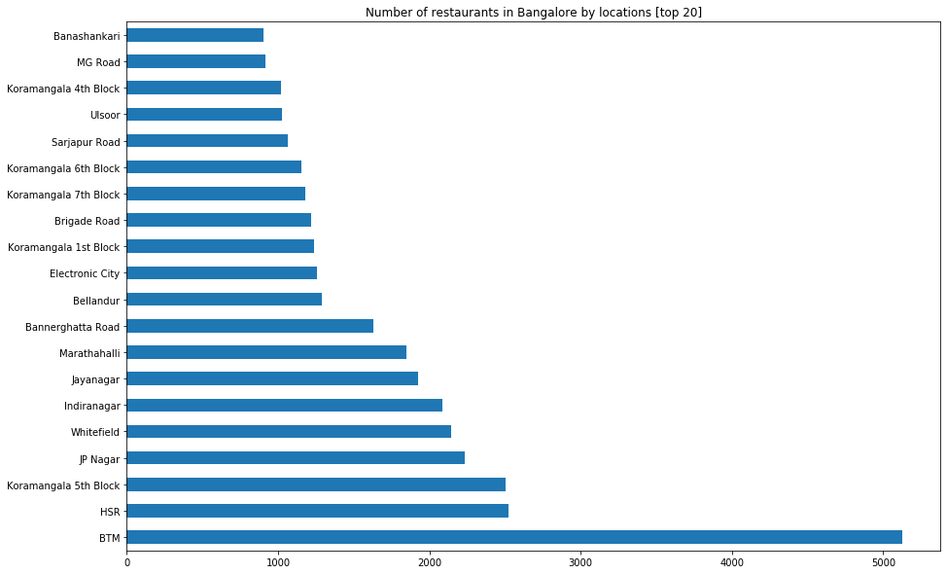
Locations of restaurants
The top 20 locations for the restaurants is listed as in the bar chart. BTM layout, HSR layout and Koramangala has the maximum number of restaurants in Bangalore

Slide 9
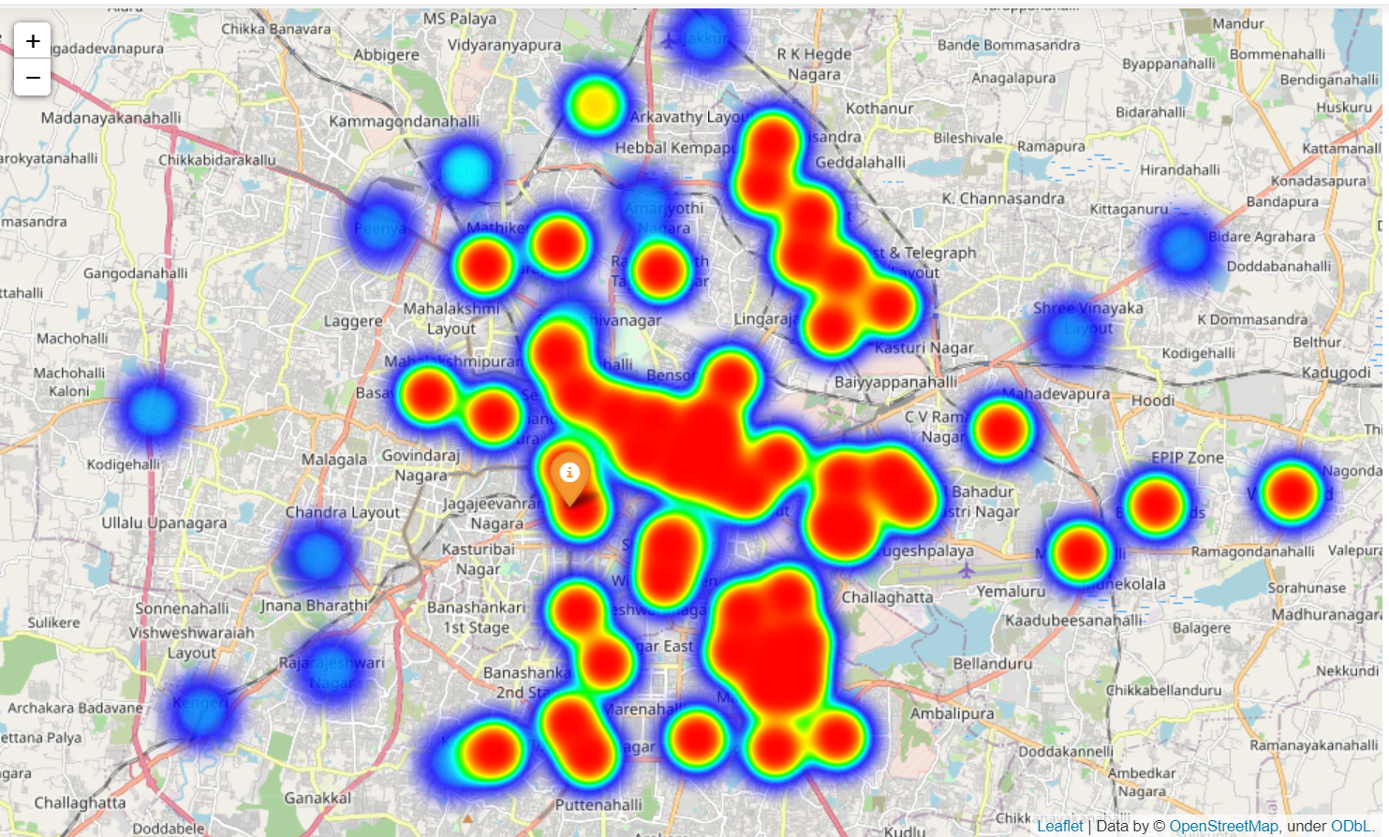
Location of Restaurants
The above prediction can be seen on the map as well

Slide 10
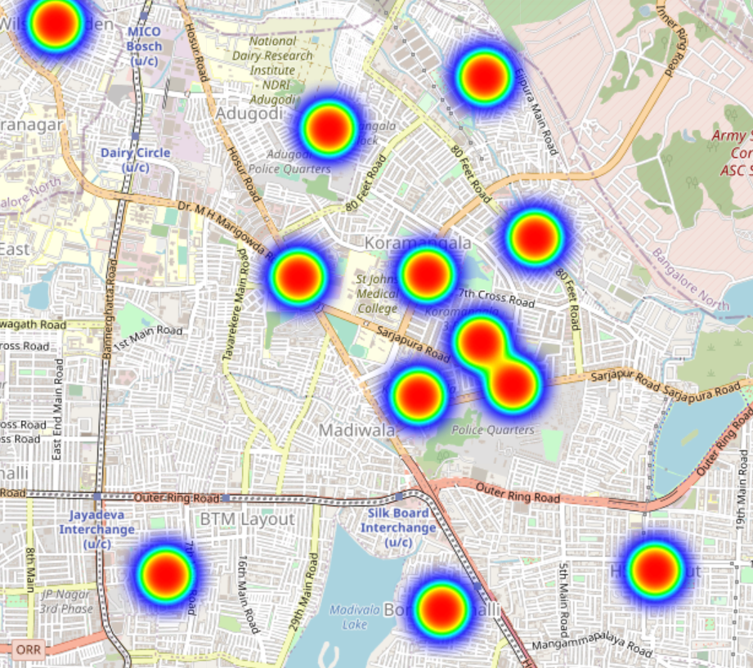
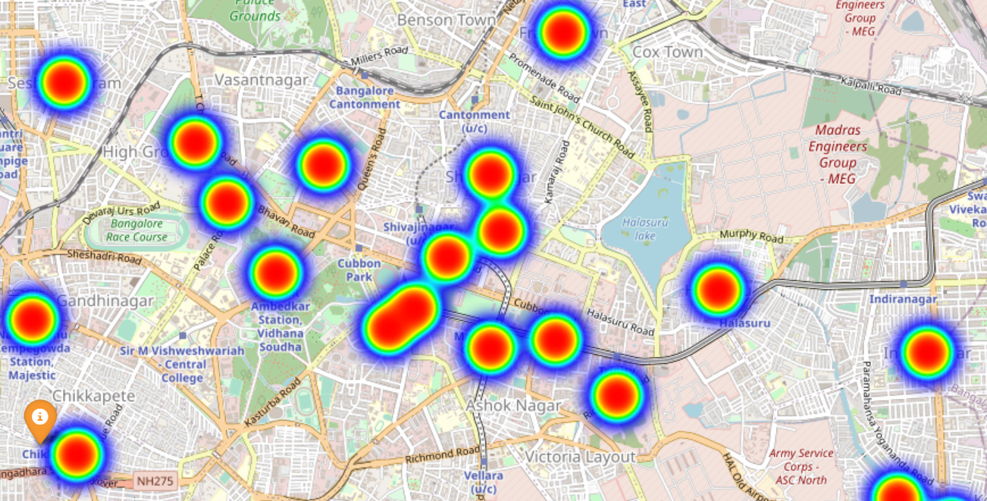
Restaurant Location
There are large number of restaurants around Shivaginagar and K R market, which is usually crowded.

Slide 11
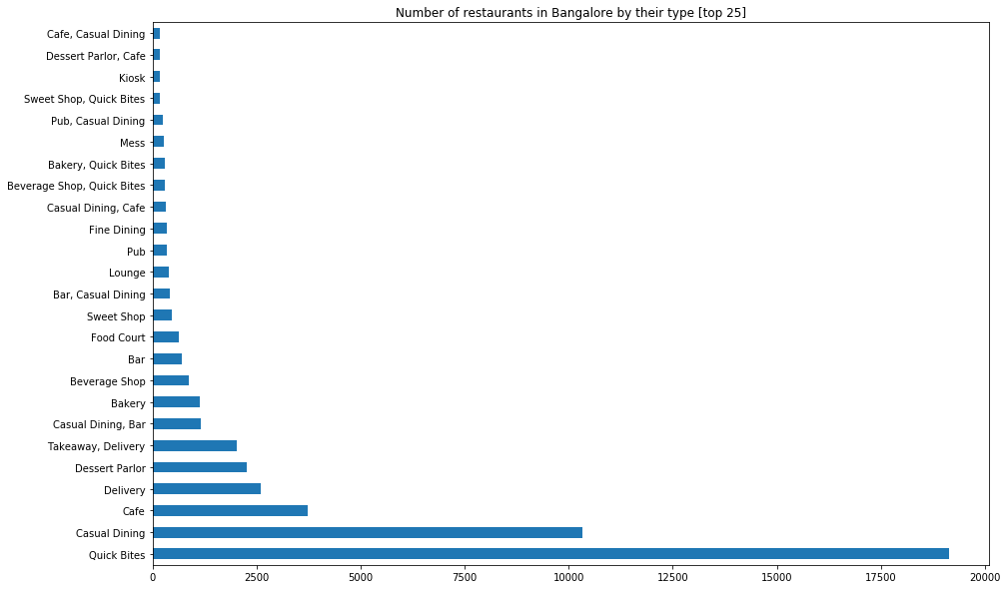
Nature of restaurants
The most preferred choice of restaurant is Quick bites and Casual dining followed by Café.

Slide 12
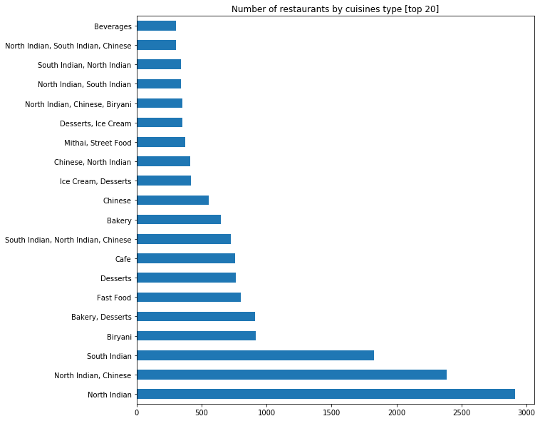
Type of restaurants
North Indian Restaurants are large in number. Many outlet serve both north and south Indian dishes.

Slide 13
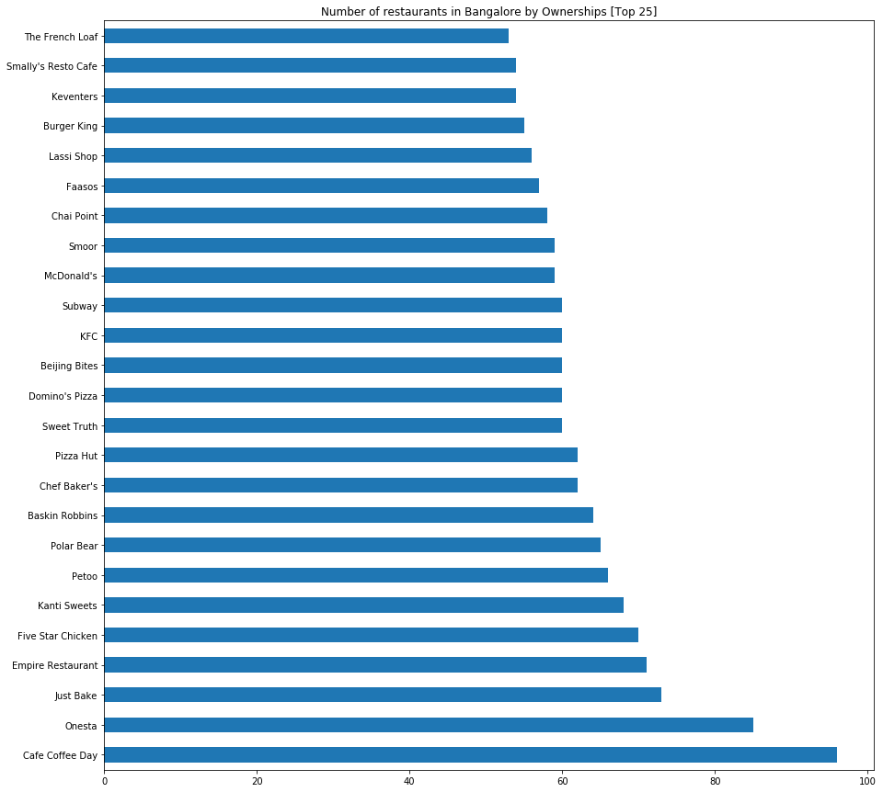
Restaurant Enterprises
Café coffee day has the largest number of outlets. However the numbers of other groups are quite comparable.

Slide 14
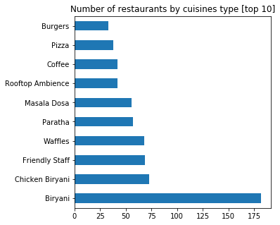
Top recipes
The most favoured recipe in Bangalore is Biriyani . Other favourite dishes are Paratha and Masala dosa

Slide 15
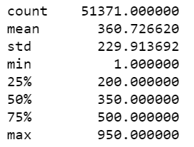
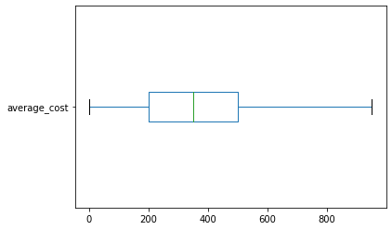
Cost analysis
The cost aspects are shown in the box plot. The average cost for two is around 360 rs while max is 950 rs.

Slide 16
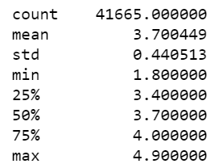
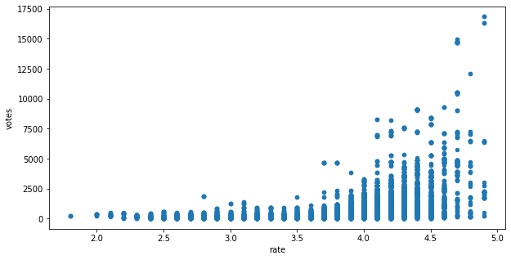
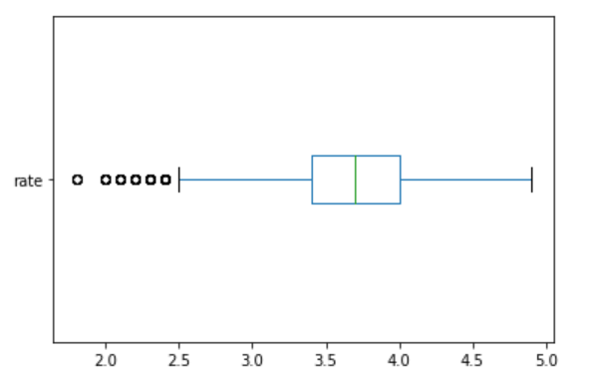
Rating and Votes
From scatter plot we can say that there are very few votes for rating below 3.5. The average rate being 3.7. The maximum rating is 4.9

Slide 17
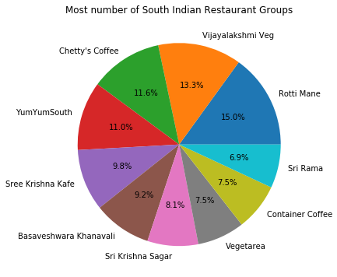
South Indian Restaurant Groups
Vijayalakshmi, chetty’s coffee and Yum Yum South has large number of outlets

Slide 18
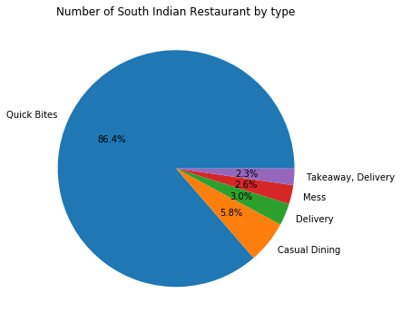
Nature of south Indian Restaurants
Almost all the south Indian restaurants are quick bite type. Very few are casual dining. One can see scope for Casual dining restaurants.

Slide 19
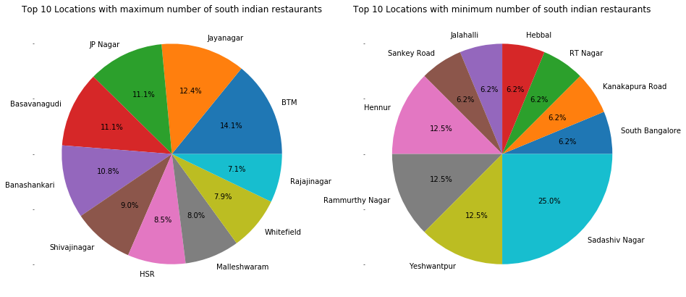
Locations with most and least number of south Indian restaurants

Slide 20
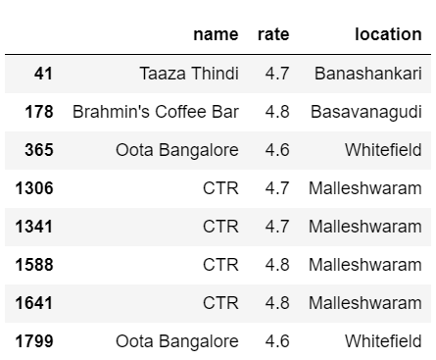
South Indian restaurants with rating > 4.5
Taaza Thindi, Bramhin’s coffee bar, Oota Bangalore and CTR are very good choice in Bangalore.

Slide 21
Results and Discussion
From the analysis we observe the following
BTM layout has maximum number of restaurants. There are more than 2000 restaurants in Whitefield already
Quick bites and Casual dining are the is the most common type of restaurant types in Bangalore. Noticeably there is large number of delivery only services without dining options.
Café coffee day has the maximum number of outlets in Bangalore followed by Onesta and Just bake which are bakeries. Empire Group is the maximum number of casual dining restaurants.
Biriyani is the most popular dish in Bangalore. Other popular menu items are masala dosa and paratha.
Most restaurants allow online delivery but few allow online table booking. This can indicate restaurants are small business.

Slide 22
Conclusion
The South Indian restaurant has quite demand since there are not many outlets in several locations when compared to other types. However most of the restaurants serve both south and north Indian style of food. One should be careful about this choice to serve only south Indian dishes.
From the analysis we can conclude that
Scope for south Indian restaurant with casual dining is large since most of them doest have seating.
Most common dishes should be masala dosa, paratha and Biriyani.
Most preferred location is around Jayanagar, JP nagar and Basavanagudi. A sepearte survey may be needed to access if there is demand for south Indian dishes in other locations.
The competition should be kept in mind: The top restaurants are Bramhin’s coffee, CTR, Oota and Taaza Thindi.
Online ordering will add value to the restaurant.

